Slide 1
Java Core Skills
Converting from Python to Java

Slide 2
Introducing Java…
Java is a statically typed object-oriented programming language
Powerful
Used in many contexts
IEEE ranks Java as the second most popular programming language globally
Guess what came first!

Slide 3
Python vs Java: High-Level Comparisons
Feature | Python | Java
Type System | Dynamically typed | Statically typed
Compilation | Interpreted | Compiled
Syntax | Indentation-based | Curly bracket/braces and semi-colons
Object-oriented Programming | Optional | Required – EVERYTHING is a class
Commented with | # | //
Data Type | Python | Java
Integer | int | int/long
Decimal point number | float | double/float
Text | str | String
True/False | bool | boolean

Slide 4

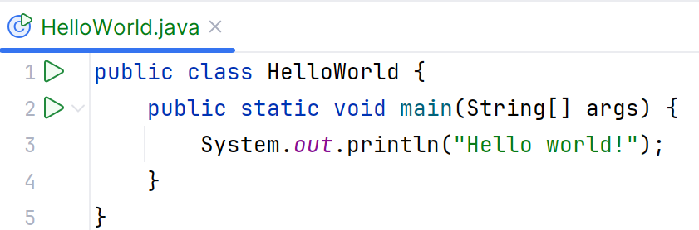
Let’s Start at the Beginning: Hello World
hello_world.py:
HelloWorld.java:
Key differences:
Java requires a class for everything
Only main() method is executable
Must use ; to end a line
Naming conventions differ!
camelCase/CapWords for Java
all_lowercase_with _underscores for Python

Slide 5
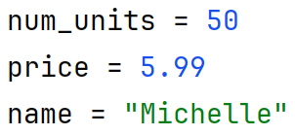
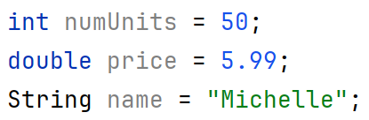
Fundamentals in Python vs Java: Data Types and Variables
Python is dynamically typed, no need to specify a type
Java is statically typed, you must explicitly specify a type for every variable when you create it

Slide 6
New Concept: Primitive vs Object
In Python, everything is an object
This means everything is treated the same
In Java, some things are primitives – simple types without methods
Primitives are more memory efficient
Primitives are compared using operators
Objects are compared using methods
Data Type | What it holds
int | Standard integer
byte | 8 bit (1 byte) integer
short | Smaller than int, bigger than short
long | Large integer (8 bytes)
double | Decimal value (larger capacity)
float | Decimal value (more efficient)
char | Single character
boolean | True/False

Slide 7
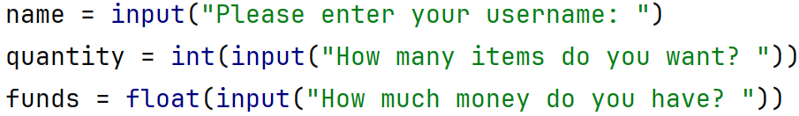
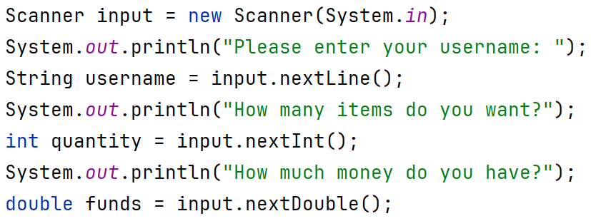
Fundamentals in Python vs Java: User Interaction
In python, everything is read in as text & then converted:
In Java, you can read in different types:
The Scanner class contains read methods for each of the core data types.
Scanner must be imported from java.util

Slide 8
Fundamentals in Python vs Java: Side Note on Input and Output
Python’s print() and input() functions are linked to the terminal/command line by default
Java requires specific instruction on where input comes from, and where output goes to
System.in -> Read from command line/terminal
System.out -> Send output to command line/terminal

Slide 9
Fundamentals in Python vs Java: Importing Classes
Python imports classes from modules
A module is a single file containing many classes and other code components
Syntax: from module_name import class_name
Java imports classes from packages
A package is a folder of class files
Syntax: import packageName.ClassName;

Slide 10
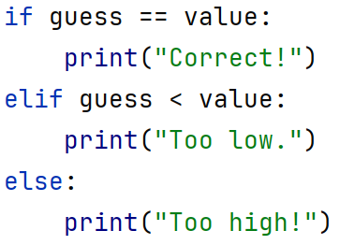
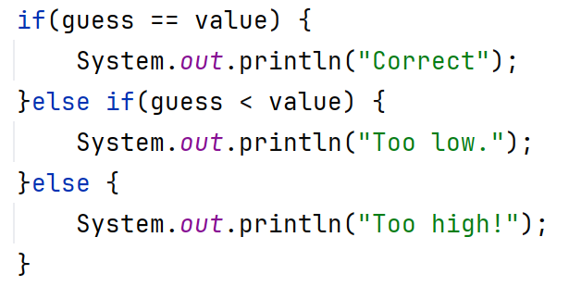
Control in Python vs Java: Conditional Syntax - if
If statement in python:
If statement in Java:

Slide 11
Control in Python vs Java: Highlighting the differences
If statement in python:
If statement in Java:
Key differences:
() are required around conditions
{} indicate the start and end of code blocks
else if used for extra conditions, not elif

Slide 12
Side Note: Conditions & Operators
 | Python | Java
True | True | true
False | False | false
Both conditions must be true | and | &&
At least one condition must be true | or | ||
Equal | == | == (.equals() for objects)
Not equal | != | !=
Not | not | !
Increasing by 1 | +=1 | ++
Decrementing by 1 | -=1 | --

Slide 13

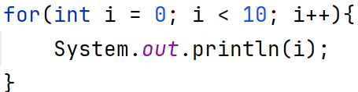
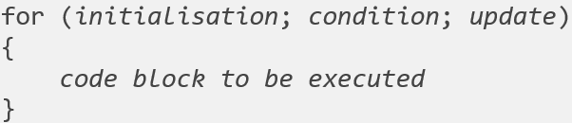
Control in Python vs Java: Loop Syntax - for
for loop in python:
for loop in Java:
initialisation
Update statement
Test Condition
True
Body of loop
False
Exit loop
Flowchart of a for loop
Line after loop

Slide 14
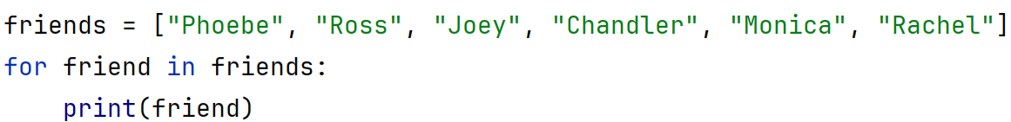
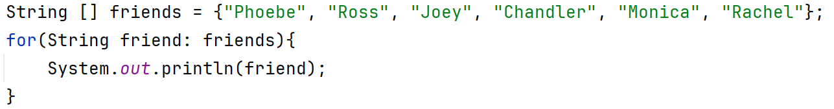
Control in Python vs Java: Loop Syntax – for each
Advanced for loop in python:
Enhanced for loop (for each) in Java:
This bring us close to a big one… arrays!
Similar: Both can loop through an iterable
Different: Strings are not iterable in Java

Slide 15
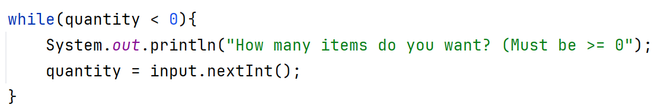
Control in Python vs Java: Loop Syntax - while
while loop in python:
while loop in Java:
Practically the same!

Slide 16

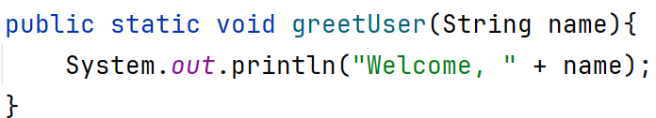
Reuse in Python vs Java: Functions & Methods
In Python, def declares a method/function:
In Java:
No dedicated keyword in Java, but you must specify:
Access level (public vs private)
Return type - This is set to void if there’s nothing being returned
Parameter types

Slide 17
Reuse in Python vs Java: Functions & Methods - Terminology
In Python:
A function is callable code outside a class
A method is callable code inside a class
In Java, everything is a method as everything is inside a class!
We’ll come back to static vs instance methods later

Slide 18
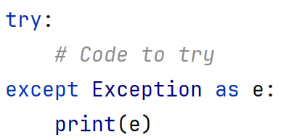
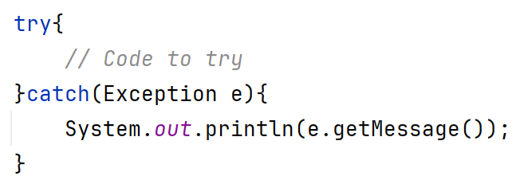
Errors in Python vs Java: Exception Handling
Basic exception handling is similar in both.
Java sometimes requires certain exceptions be handled
In Python:
In Java:
Obviously you would catch the specific exception that might occur, not just a general one!!

Slide 19
Built-In Data Structures in Python vs Java
Python | Java
List [] my_list = [] | ArrayList/LinkedList ArrayList<String> myList = new ArrayList<>();
Dictionary {} my_dict = {} | HashMap HashMap<Integer, String> my_dict = new HashMap<>();
Tuple () my_tuple = () | Not available!
Java’s data structures must be imported from java.util
You can only store ONE type of data in a data structure
All actions are done through methods – no operators!

Slide 20
Last of all: Introducing the array
Arrays are a foundational component of data storage in Java (and many other programming languages)
Store many elements in any order (usually order of occurrence)
Each array can store a single type
All data within the array is the same type – defined at declaration
Arrays are a continuous section of memory
Can access any slot within that section using arrayName[index]
Unlike lists, the size of an array can’t be expanded on demand
The size of an array is defined at creation
We need to build a whole new continuous section to “grow” it

Slide 21
Creating an array
To create an empty String array with 10 slots:
To create a populated String array:
[] on the left of = indicates the variable will hold an array
This is always included
[] on the right of = is used to specify the number of slots to be created
Used when creating a blank array

Slide 22
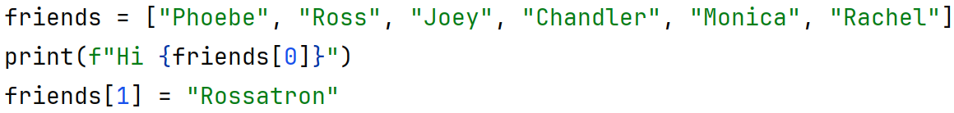
Accessing an Element in an array
Array elements are accessed the same way we access a list element in python – using the position/index
In Java:

Slide 23
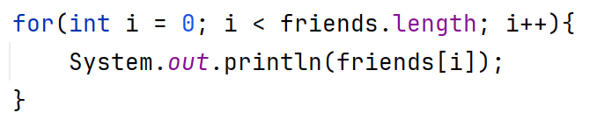
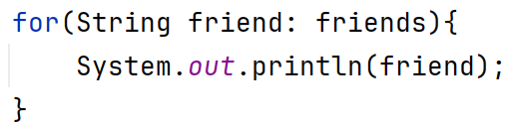
Iterating Through an array
This can be done with both a standard or enhanced for loop.
Standard:
Enhanced:
Find the length of an array using .length
(No brackets as it’s an attribute, not a method)

